Slide 1

Microsoft Movie Analysis
Phase 1 Project
Author: Carla Kirby
Notes:
Welcome to the Microsoft Movie Analysis Presentation, my name is Carla Kirby and thank you so much for joining me today. Today we are presenting some analytical findings to the Microsoft Studio Stakeholders for consideration and implementation into their newest innovative idea Microsoft film studio’s.

Slide 2

Presentation Outline
Business Problem
Data
Methods
Results
Conclusions
Notes:
Id like to begin by outlining the presentation just so everyone on the same page. We will discuss the business problem, review some interesting findings , discuss the methods used to filter that information, the results and finally summarize the conclusion of those findings.

Slide 3

Business Problem
Microsoft Movie Studios requires critical intel on the types of films frequent movie goers prefer watching at the box office.
This presentation will provide clarity on the genres doing the best financially at the box office on a domestic level.
Microsoft intends to utilize this data to determine what types of films to produce for their new studio.
Notes:
Microsoft sees all the big companies creating original video content and they want to get in on the fun.
create a new movie studio
don’t know anything about creating movies. – context for the video content
exploring what types of films are currently doing the best at the box office.
We intend on translating those findings into actionable insights that Microsoft stakeholders will consider, - What are the top grossing genres, basically.

Slide 4

Data
Courtesy of IMDb
In order to maintain data quality and consistency null values were removed, csv data sets were combined via movie title, and relevant data points were selected to focus on the business problem.
No irrelevant or erroneous data was utilized.
Notes:
Just a little information on the data –courtesy of IMDb and BOM have some credible content on their website. We were able to imbed that into our report.
IMDB and BOM have extreme amounts of information related to movies and we have chose data that is critical to the business problem that we endeavor to help solve. Which is genre based and obviously with profitability in mind for Microsoft. Plus we want to select the movie types that people would prefer to see at the theatre.

Slide 5
Methods
The methods used to prepared the data are listed below:
Importation of relevant packages to map data frames
Merged datasets to gain a further insight
Data exploration and manipulation methods to obtain mean and unique values
Sorted “Top Ten” films via highest domestic gross value and production studio
Visualized findings based on connections relevant to the business query
Notes:
Just a little information on the data –courtesy of IMDb and BOM have some credible content on their website. We were able to imbed that into our report.
IMDB and BOM have extreme amounts of information related to movies and we have chose data that is critical to the business problem that we endeavor to help solve. Which is genre based and obviously with profitability in mind for Microsoft. Plus we want to select the movie types that people would prefer to see at the theatre.

Slide 6


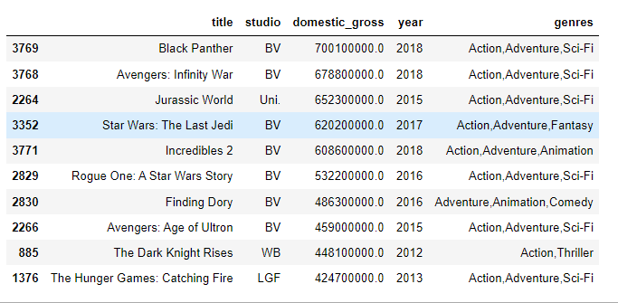

Results
Black Panther, Avengers – Infinity War and Jurassic World
grossed the highest domestically
Notes:
Our top 3 box office hits are Black Panther, Avengers Infinity War and Jurassic World. Buena Vista produced the Black panther and infinity war and Jurassic world was produced by universal studios.

Slide 7
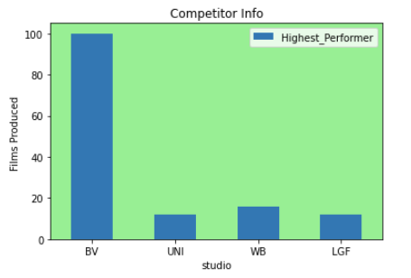
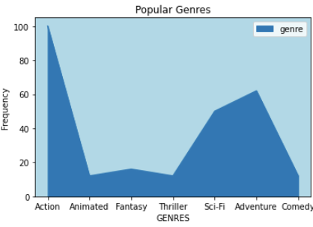
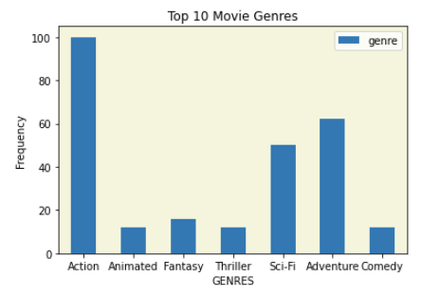



Slide 8
Conclusions with Recommendations
2. ADVENTURE FILMS ARE THE SECOND MOST WATCHED FILMS, OFTEN COUPLED WITH ACTION GENRES
1. Action Films grossed higher than frequently cited dramas
3. SCI-FI FILMS PLACE THIRD AND ARE CONSIDERED A TOP PERFORMING GENRE
I HIGHLY RECOMMEND RESEARCHING Marvel Studios’(BV) METHODS OF PRODUCING MOVIES.
THE DATA INDICATES THEY ARE A TOP PERFORMER IN THE INDUSTRY
AND PRODUCE THE HIGHEST GROSSING BOX OFFICE HITS.

Slide 9
Conclusion
After analyzing the dataset, I have arrived at the conclusion that the types of films that do the best in the box office domestically are Action, Adventure, and Sci-Fi films.
I highly recommend that Microsoft do some further research on the Marvel Studios (BV) methods of producing as they provide high grossing box office films.

